Slide 1
T-Cell Receptor Kinetics
CS694-A
Yifan Wang
Michael Fang

Slide 2
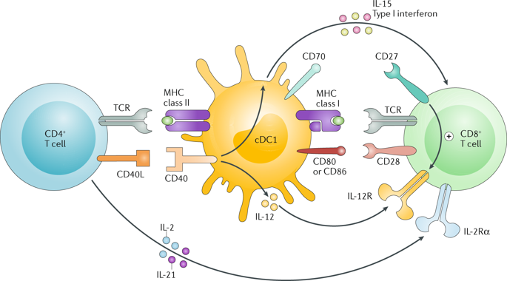
T Cells
T-Cell Receptor
T-Cell Receptor
https://www.nature.com/articles/s41577-018-0044-0
Notes:
T Cells are immune cells predominantly mature in the Thymus (as opposed to B cells, produced in the Bone)
T cells are part of cell-mediated immunity (i.e. not B-cell secreting antibodies); by attaching to epitopes of foreign antigens,

Slide 3
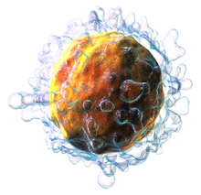
T Lymphocyte
T-cells are a type of white blood cell
Integral in adaptive immune system
Identified by presence of T-cell receptor (TCR)
Classes:
Helper – maturation of B cells (plasma, memory), activation of cytotoxic T
Cytotoxic – express CD8+ glycoprotein, bind MHC-I antigens, degradation by antigen processing (ubiquination, proteasome degradation)
Memory – antigen-experienced, reproduce to mount faster/stronger immune response
Regulatory – shut down immunity at end of immune response, suppress autoreactive T-cells
Picture: https://en.wikipedia.org/wiki/T_cell

Slide 4
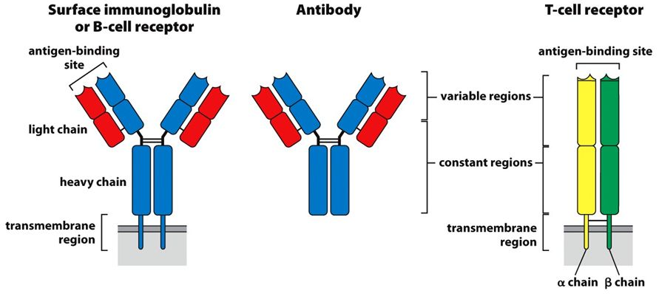
T-Cell Receptor

Slide 5
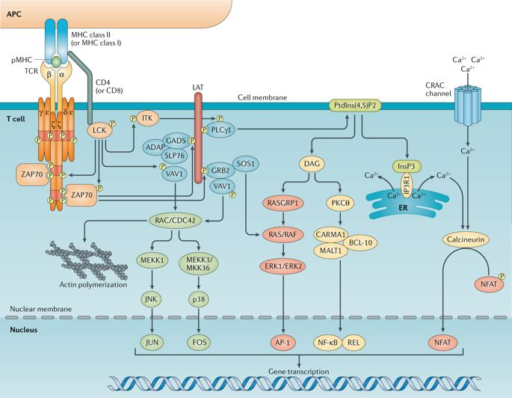
T-Cell Receptor Signal Transduction Pathway
https://www.nature.com/articles/s41577-018-0020-8
Notes:
The takeaway message:
It’s complicated.
There are models of the pathways, but not necessarily agreement on the precise order or kinetics.
A number of molecules do not have their structures described yet.
There is a lot of crosstalk, so kinetics may be affected by other reactions we don’t know about yet.

Slide 6
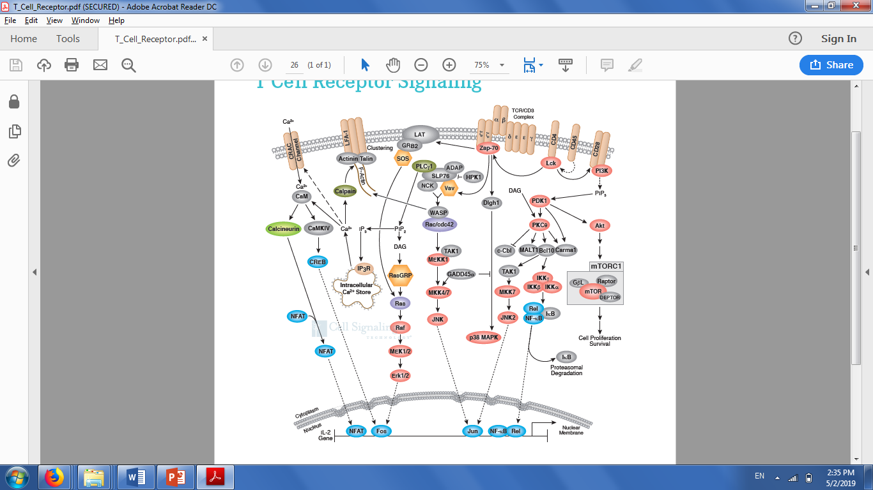
Other Models
Courtesy of Cell Signaling Technology, Inc

Slide 7
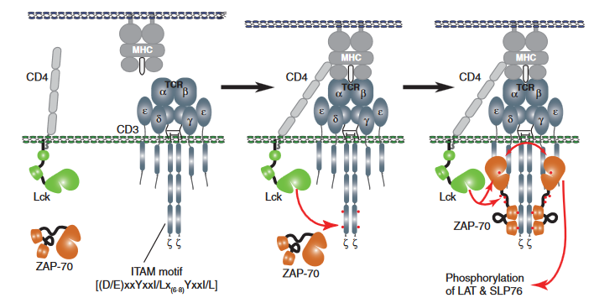
Cell Surface reactions
Target cell
Extracellular space
Intracellular (T-cell)
TCR/CD3 + ZAP70 -> TCR/CD3+ZAP70, ka = 5x10^6 /M*s
This is fast.
Model per Wang et al., rate per Bu et al.

Slide 8
ZAP70 phosphorylation of SLP76 reactions

Slide 9
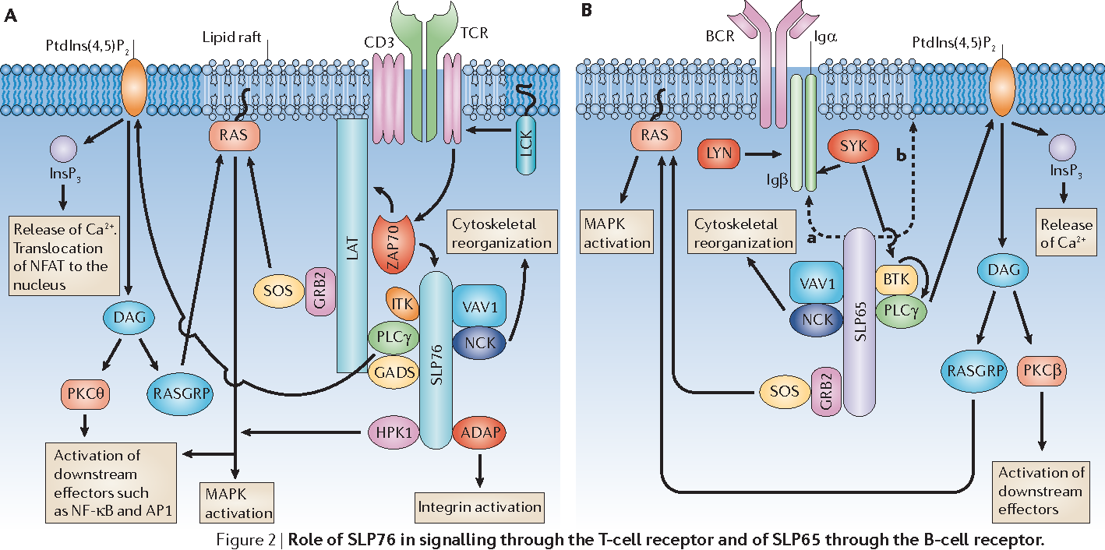
ZAP70 phosphorylation of SLP76 reactions
ZAP70 stands for “zeta-chain-associated protein kinase of 70kDa”
SLP76 stands for “SH2 domain containing leukocyte protein of 76kDA”
Rates? Nobody knows.
Structure? Not yet solved.
https://www.semanticscholar.org/paper/SLP76-and-SLP65%3A-complex-regulation-of-signalling-Koretzky-Abtahian/b9fb539da060294253a6fd1056122a084560b0b6/figure/1

Slide 10
Phosphoinositide Cascade Reactions

Slide 11
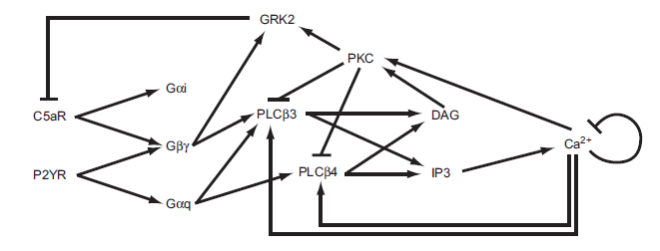
Phosphoinositide Cascade Reactions

Slide 12
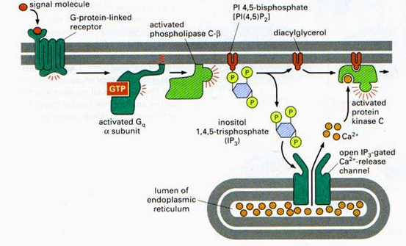
Phosphoinositide Cascade Reactions
Reaction, IP3 synthesis | Kf | Kr
PLCb3 + Ca2+ ⬄ PLCb3-Ca2+ | 20 | 8
Gaq-GTP + PLCb3-Ca2+ ⬄ PLCb3-Ca2+-Gaq-GTP | 50 | 0.1
PLCb3-Ca2+-Gaq-GTP + PIP2 ⬄ PLCb3-Ca2+-Gaq-GTP-PIP2 | 70.88 | 1
PLCb3-Ca2+-Gaq-GTP-PIP2 -> PLCb3-Ca2+ + Gaq-GDP + IP3 + DAG | 27.90 | X
Reaction, Gby and PLCb3 | Kf | Kr
Gby + PLCb3-CA2+ ⬄ PLCb3-CA2+-Gby | 8.35 | 0.39
PLCb3-CA2+-Gby + PIP2 ⬄ PLCb3-CA2+-Gby-PIP2 | 165.83 | 8
PLCb3-CA2+-Gby-PIP2 -> PLCb3-CA2+-Gby + IP3 + DAG | 5.42 | X
Reaction, Gaq and PLCb4 | Kf | Kr
PLCb4 + Ca2+ ⬄ PLCb4-Ca2+ | 20 | 8
Gaq-GTP + PLCb4-Ca2+ ⬄ PLCb4-Ca2+-Gaq-GTP | 62.55 | 10.63
PLCb4-Ca2+-Gaq-GTP + PIP2 ⬄ PLCb4-Ca2+-Gaq-GTP-PIP2 | 1238.79 | 1
PLCb4-Ca2+-Gaq-GTP-PIP2 -> PLCb4-Ca2+-Gaq-GDP + IP3 + DAG | 22.85 | X
Reaction, IP3R | Kf | Kr
IP3R + IP3 ⬄ IP3R-IP3 | 177.47 | 2.2
IP3R-IP3 + Ca2+ ⬄ IP3R-IP3-Ca2+ | 0.411 | 0.0434
IP3R + Ca2+ ⬄ IP3R-Ca2+ | 0.9 | 0.806
IP3R-Ca2+ + IP3 ⬄ IP3R-IP3-Ca2+ | 20 | 0.029233
Reaction | Kex | Vex
3 Na+ in, 1 Ca 2+ out, Km ~2-5uM | 0.25uM | 0.023uM/s
Reaction, PKC | Kf | Kr
PKC + DAG ⬄ PKC-DAG | 100 | 0.05
PKC-DAG + Ca2+ ⬄ PKC-DAG-Ca2+ | 10 | 6
PKC + Ca2+ ⬄ PKC-Ca2+ | 0.01 | 30
PKC-Ca2+ + DAG ⬄ PKC-DAG-Ca2+ | 1000 | 0.0001
From Purutçuoğlu et al.

Slide 13
Phosphoinositide Cascade Reactions
Reaction, PLCb phosphorylation | Kf | Kr
PKC-DAG-Ca2+ + PLCb3-CA2+ ⬄ PKC-DAG-Ca2+-PLCb3-Ca2+ | 830.44 | 111
PKC-DAG-Ca2+-PLCb3-CA2+ -> PKC-DAG-Ca2+ + PLCb3p-Ca2+ | 11.70/s | X
PKC-DAG-Ca2+ + PLCb4-CA2+ ⬄ PKC-DAG-Ca2+-PLCb4-Ca2+ | 5.90 | 11
PKC-DAG-Ca2+-PLCb4-Ca2+ -> PKC-DAG-Ca2+ + PLCb4p-Ca2+ | 0.93/s | X
Reaction, G-protein Receptor Kinase (GRK) | Kf | Kr
PKC-DAG-Ca2+ + GRK ⬄ PKC-DAG-Ca2+-GRK | 77.52 | 10
PKC-DAG-Ca2+-GRK -> PKC-DAG-Ca2+ + GRKp | 18.34/s | X
GRKp + Gby ⬄ GRKp-Gby | 4.98 | 0.05
GRKp-Gby + C5aC ⬄ GRKp-Gby-C5aC | 591.54 | 12.37
GRKp-Gby-C5aC -> GRKp-Gby + C5aCp | 199.31/s
Reaction, Dephosphorylation | Kf | Kr
PLCb3p-Ca2+ -> PLCb3-CA2+ | 0.12/s | X
PLCb4p-Ca2+ -> PLCb3-CA2+ | 0.12/s | X
C5aCp -> C5aR + C5a ////NOT NECESSARY | 0.001 | X
Reaction, DAG degradation | Vmax/Kf | Km/Kr
DAG -> null | 0.35/s
IP3 + IP3Ka ---> IP4 + IP3Ka | 13.9 | 0.0557
IP4 ---> IP5 | 100 | 1.4
IP5 -> PIP2 | 0.008

Slide 14
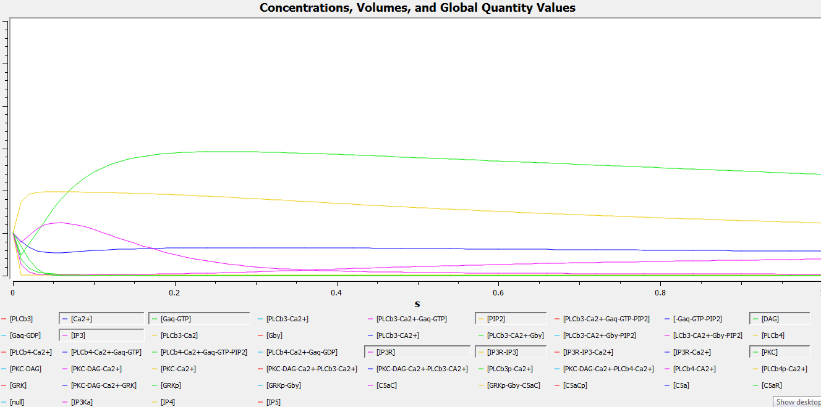
Phosphoinositide Cascade in COPASI
DAG
IP3R-IP3
IP3
Ca2+

Slide 15
MAPK/ERK Pathway
MAPK = mitogen-activated protein kinase
Mitogen = chemical (usu. protein) that induces mitosis, cell division
Note the straight-line set of reactions down this path

Slide 16
MAPK/ERK Pathway
From Purutçuoğlu et al.
1 Grb2 SOS → Grb2-SOS
2 EGFR Shc Grb2-SOS → EGFR Shc-Grb2-SOSm
3 EGFR Grb2-SOS → EGFR Grb2-SOSm
4 Shc-Grb2-SOSm → Shc Grb2-SOS
5 Grb2-SOS → Grb2 SOS
6 Shc-Grb2-SOSm Ras.GDP → Shc-Grb2-SOSm Ras.GTP
7 Grb2-SOSm Ras.GDP → Grb2-SOSm Ras.GTP
8 Ras.GTP → Ras.GDP
9 GAP Ras.GTP → GAP Ras.GDP
10 Raf PP2A → Raf.I PP2A
11 Raf.I Ras.GTP → Raf.Im Ras.GTP
12 Raf.Im Ras.GTP PAK → Raf.Am Ras.GTP PAK
13 PP5 Raf.Am → PP5 Raf.Im
14 Raf.Im → Raf
15 Raf.I-Ras.GTPm → Raf.Im Ras.GTP
16 Raf.Am MEK → Raf.Am MEK.p2
17 PAK MEK → PAK MEKF
18 MEKF Raf.Am → MEK.p2 Raf.Am
19 MEK.p2 ERK → MEK.p2 ERK.p2
20 ERK.p2 MEK → ERK.p2 MEKS

Slide 17
MAPK/ERK Pathway
21 MEKS Raf.Am → MEK.p2 Raf.Am
22 ERK.p2 Shc-Grb2-SOSm → ERK.p2 Shc-Grb2m SOS
23 ERK.p2 Grb2-SOSm → ERK.p2 Grb2m SOS
24 Shc-Grb2m → Shc Grb2
25 Grb2m → Grb2
26 ERK.p2 TF → ERK.p2-TF.p2
27 ERK.p2-TF.p2 c-Fos.DNA → ERK.p2-TF.p2 c-Fos.DNA c-Fos.RNA c-Fos
28 ERK.p2 c-Fos → ERK.p2 c-Fos.p
29 ERK.p2-TF.p2 MKP.DNA → ERK.p2-TF.p2 MKP.DNA MKP.RNA MKP
30 MKP ERK.p2 → MKP ERK
31 ERK.p2 RSK → ERK.p2-RSK.A
32 ERK.p2-RSK.A TF → ERK.p2-RSK.A-TF.p2
33 ERK.p2-RSK.A-TF.p2 c-Fos.DNA → ERK.p2-RSK.A-TF.p2 c-Fos c-Fos.DNA
c-Fos.RNA
34 ERK.p2-RSK.A c-Fos → ERK.p2-RSK.A c-Fos.p
35 ERK.p2-RSK.A-TF.p2 MKP.DNA → ERK.p2-RSK.A-TF.p2 MKP MKP.DNA
MKP.RNA
36 MKP ERK.p2-RSK.A → MKP ERK RSK
37 ERK.p2-TF.p2 → ERK.p2 TF
38 ERK.p2-RSK.A → ERK.p2 RSK
39 ERK.p2-RSK.A-TF.p2 → ERK.p2-RSK.A TF

Slide 18
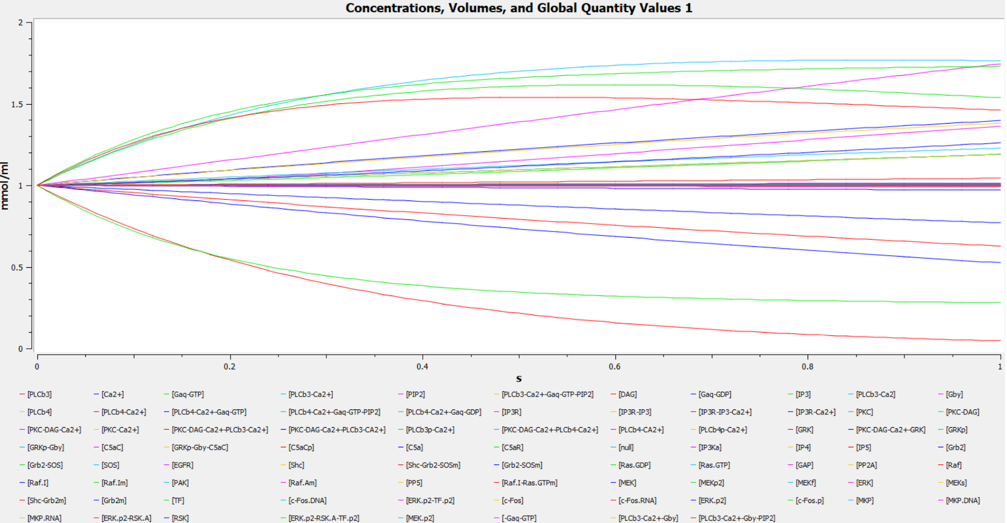
MAPK/ERK Pathway in COPASI

Slide 19
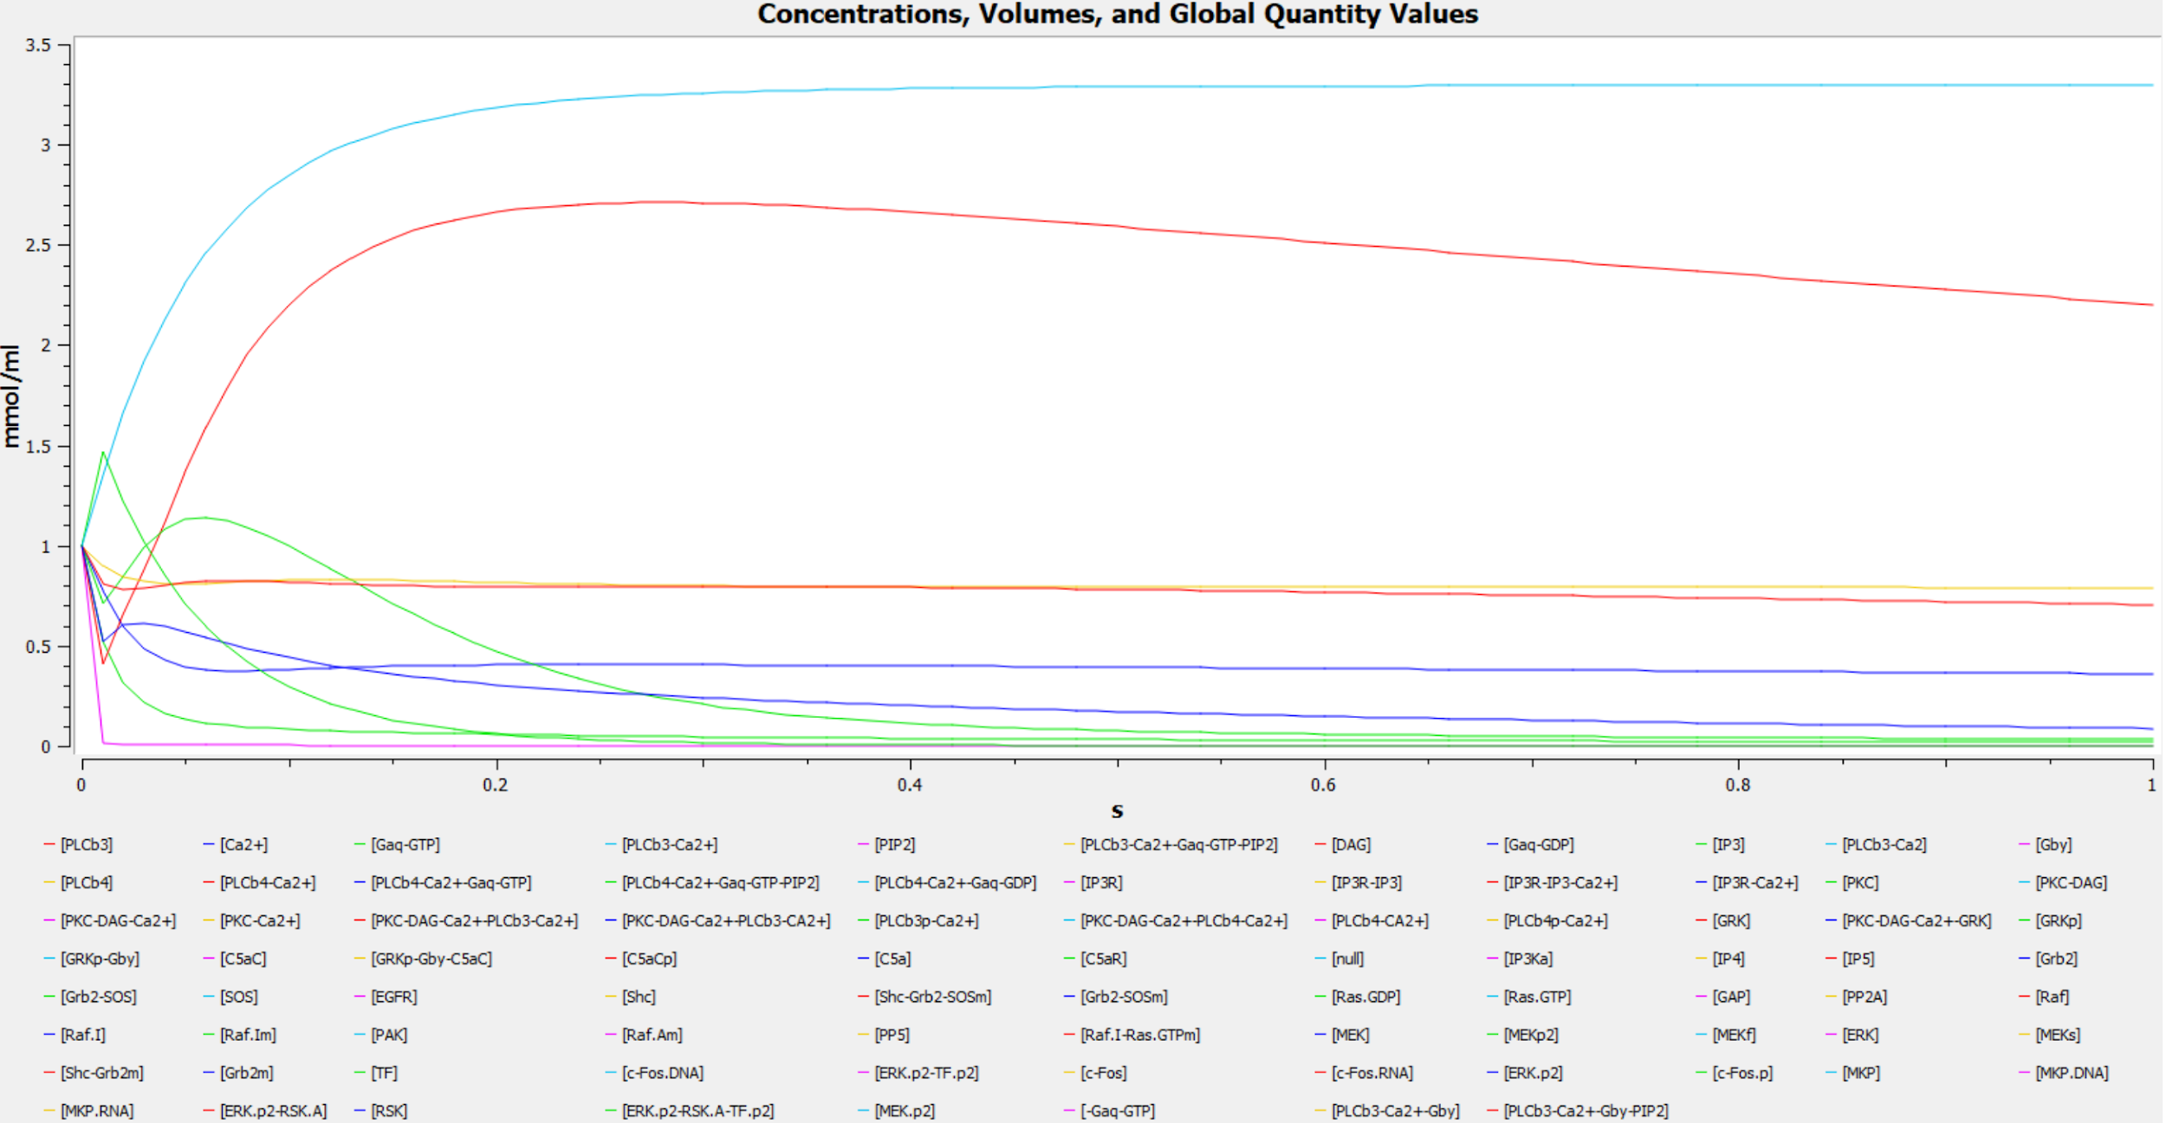
IP3 synthesis by Gaq, activated by PLCb3

Slide 20
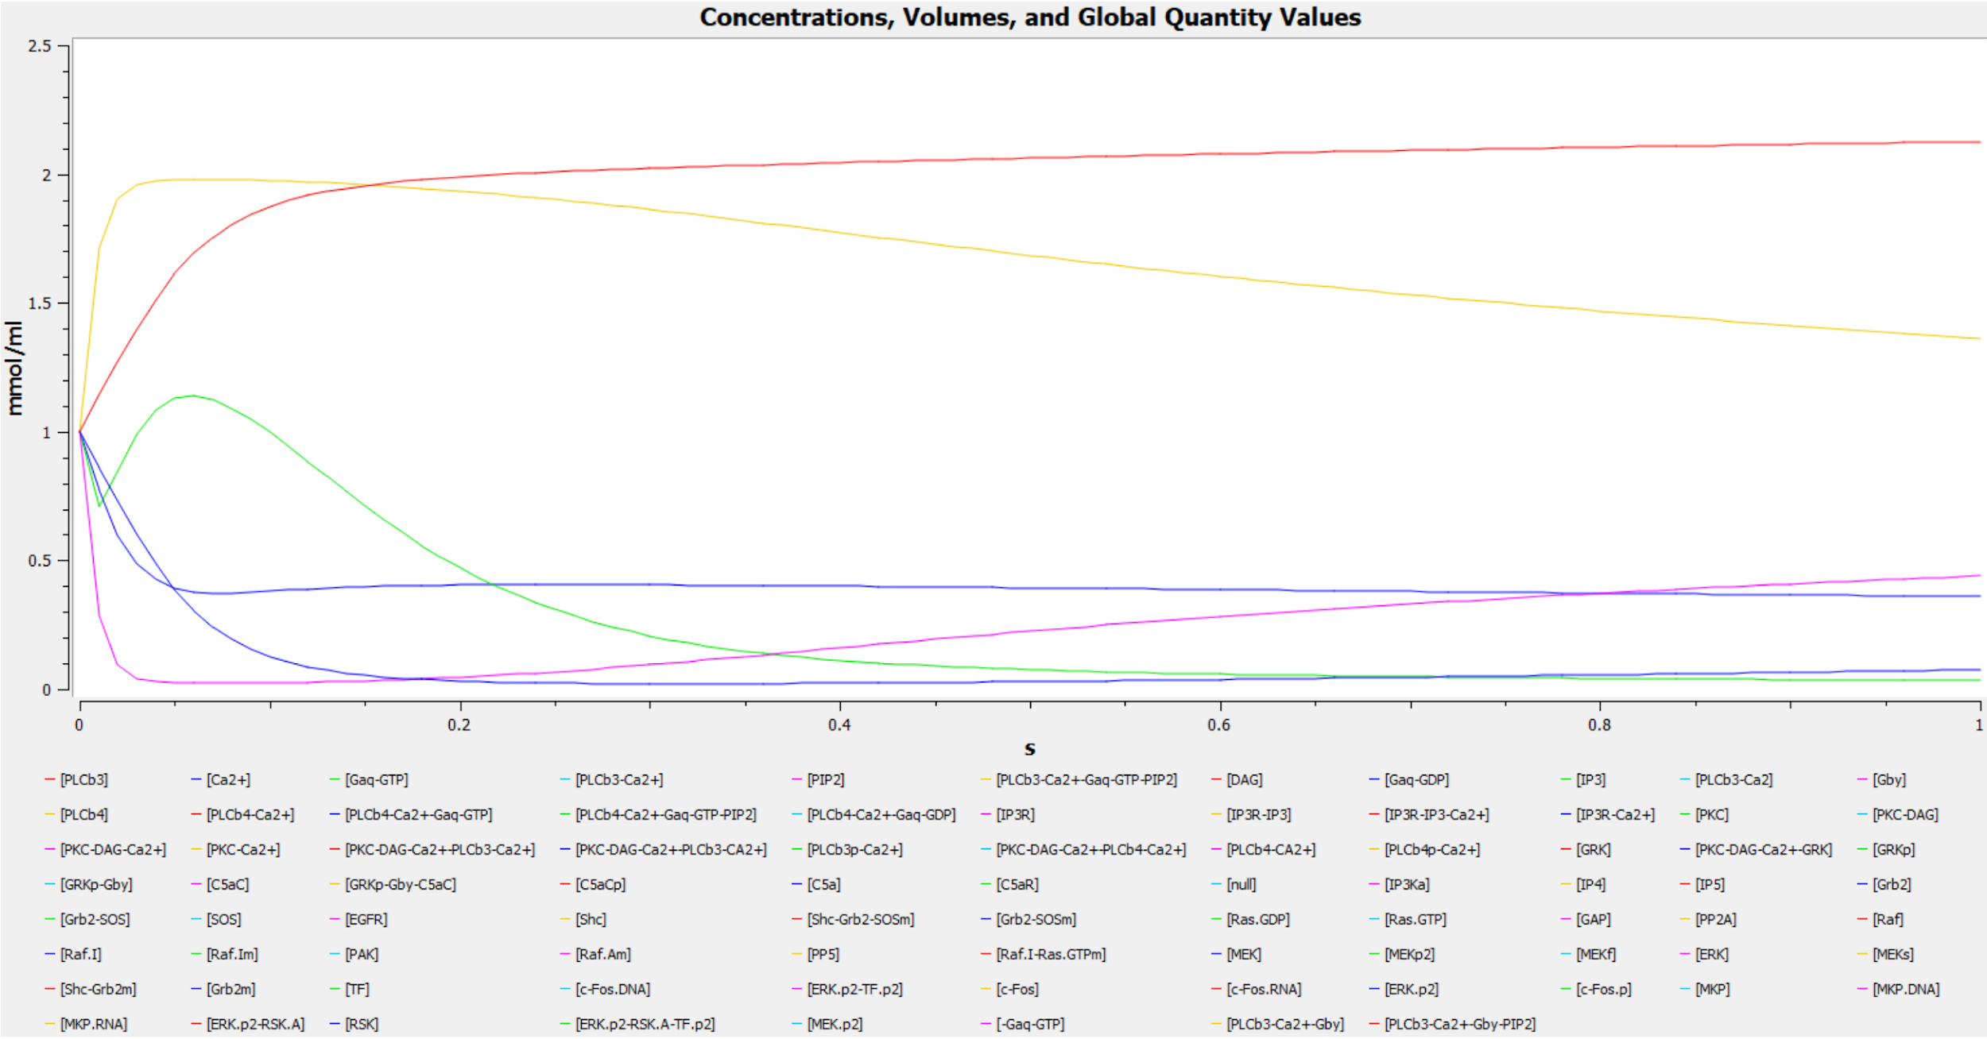
Phosphoinositide Cascade Reactions
Gby and PLCb3 reactions

Slide 21
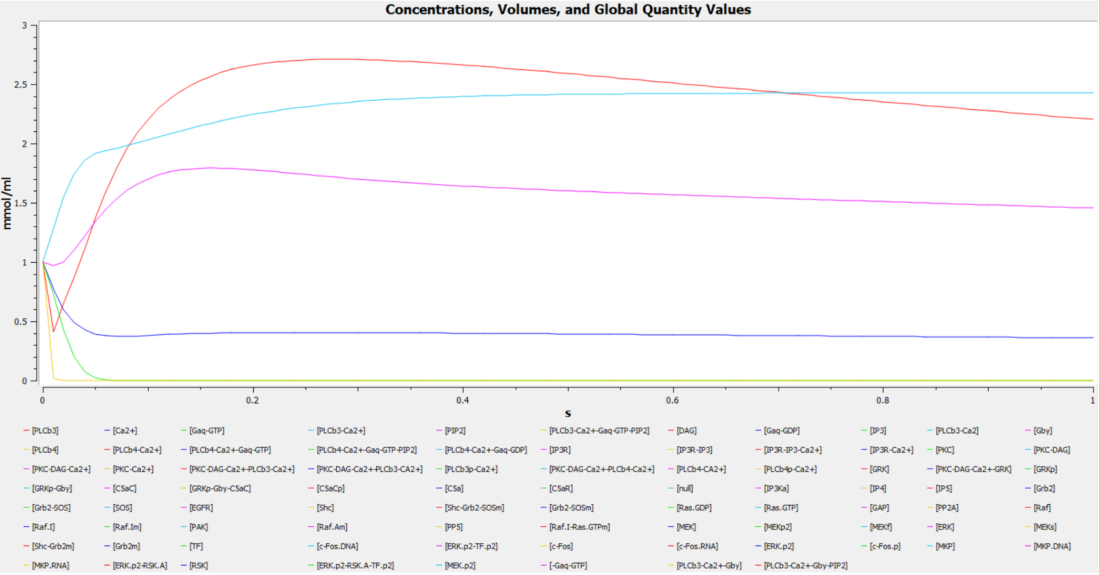
Gaq and PLCb4 reactions

Slide 22
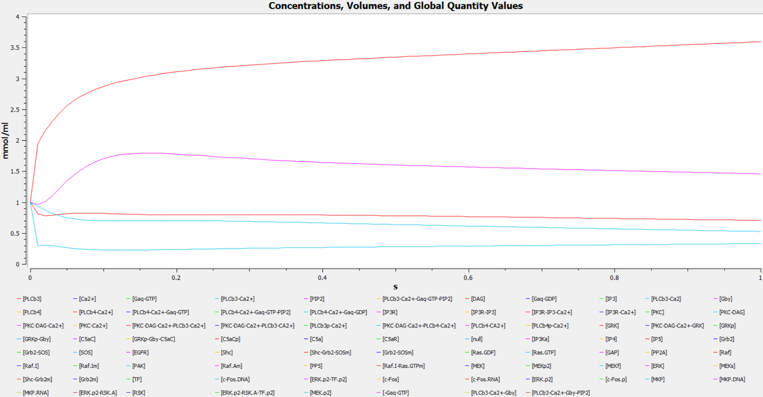
IP3 receptor (IP3R) reaction rates

Slide 23
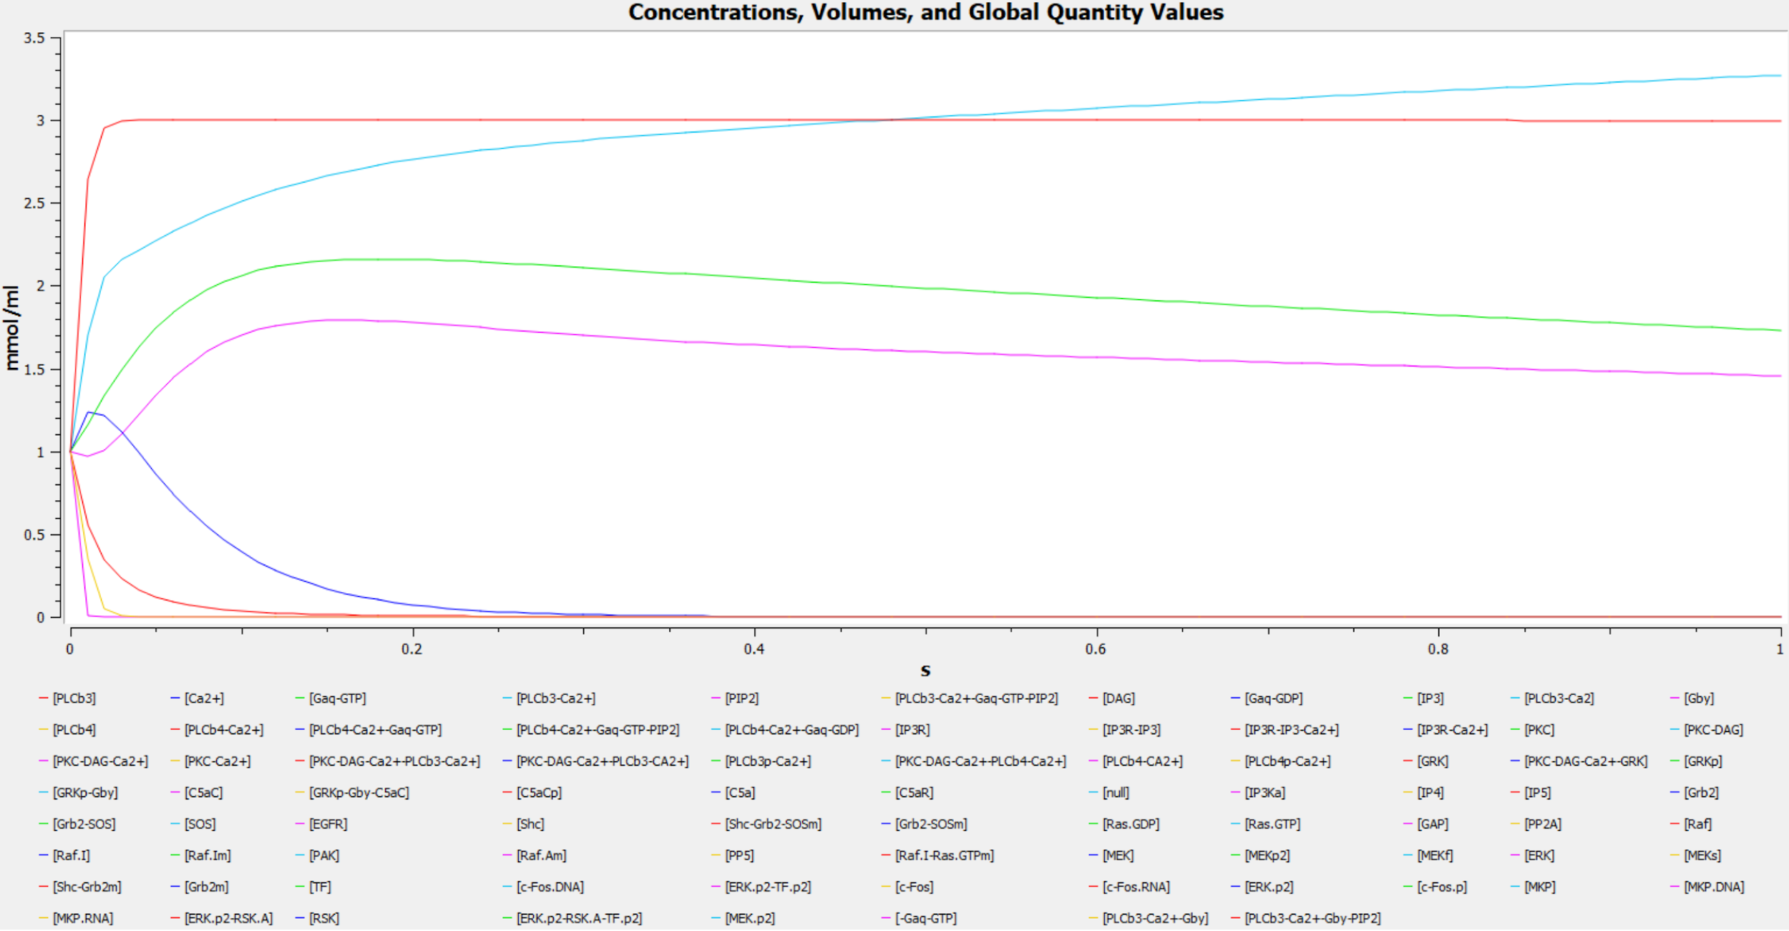
Protein Kinase C reaction

Slide 24
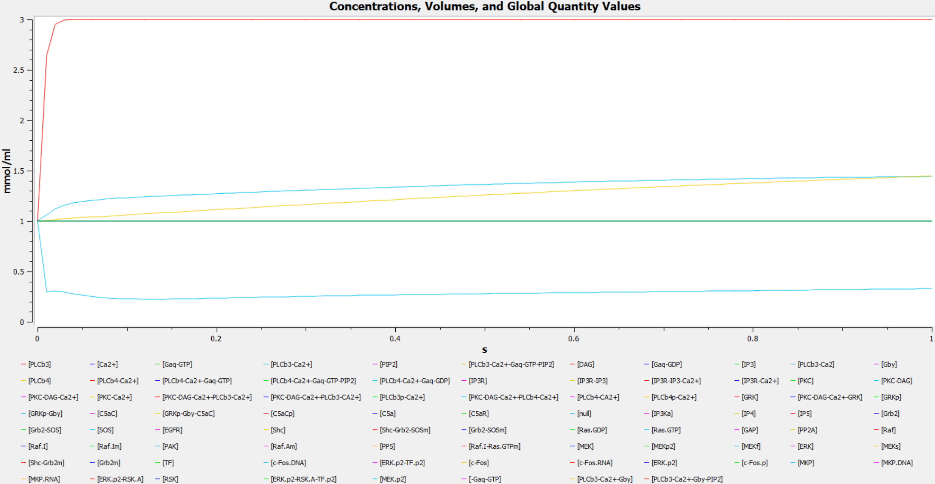
PLCb phosphorylation by PKC rate constants

Slide 25
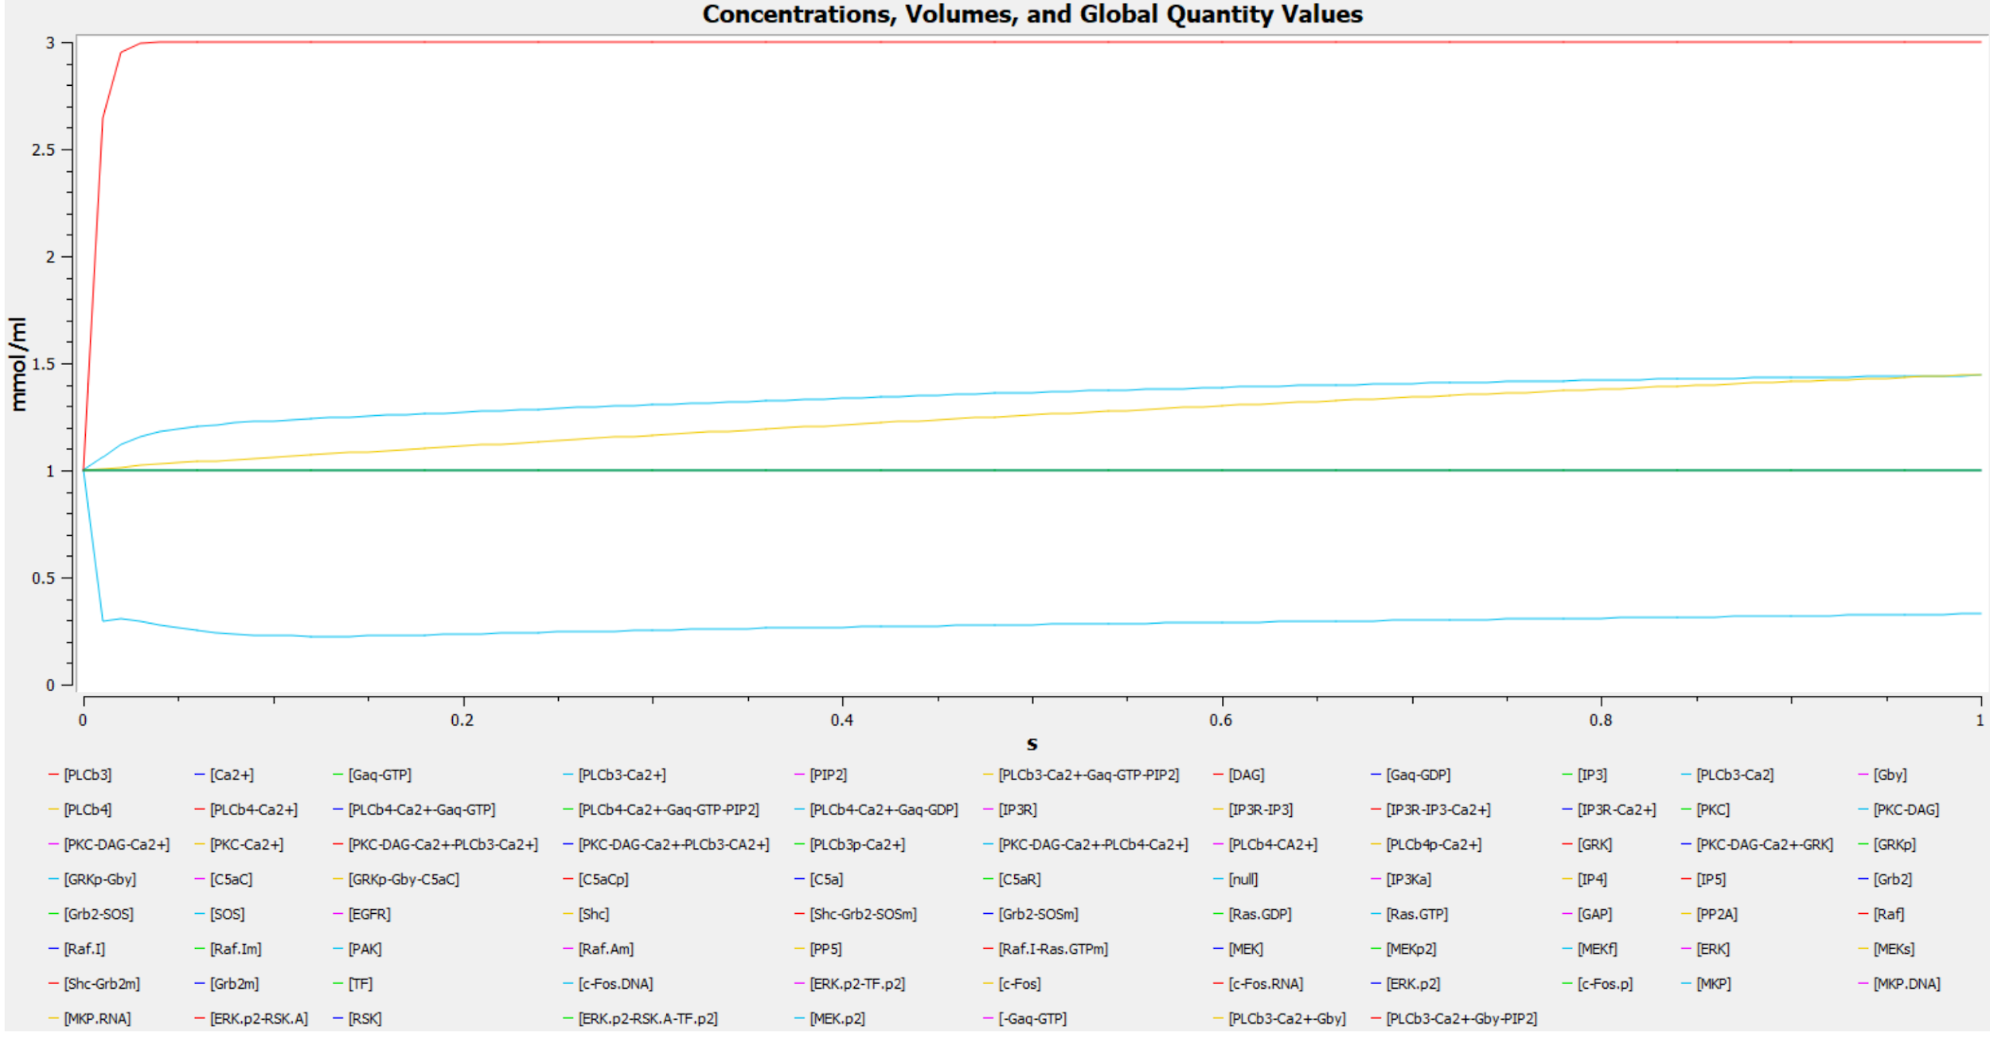
DAG degredation/dephosphorylation

Slide 26
Discussion
Why focus on T-Cell Receptor?
Many downstream elements (IP3, MAPK, AKT, cFOS, mTOR) are directly involved in cell survival and proliferation.
c-FOS, for example, is a proto-oncogene, and is overexpressed in a variety of cancers; it is a predictor of decreased survival in breast cancer.
Although mechanism is not fully known, control of these pathways may allow for entrainment of T-Cells.

Slide 27
Works Cited
Bu JY, Shaw AS, Chan AC. Analysis of the interaction of ZAP-70 and syk protein-tyrosine kinases with the T-cell antigen receptor by plasmon resonance. Proc Natl Acad Sci U S A. 1995 May 23;92(11):5106-10.
Jinsung Hong, Stephen P. Persaud, Stephen Horvath, Paul M. Allen, Brian D. Evavold and Cheng Zhu. Force-Regulated In Situ TCR-Peptide-Bound MHC Class II Kinetics Determine Functions of CD4+ T Cells. doi: 10.4049/jimmunol.1501407 J Immunol 2015; 195:3557-3564; Prepublished online 2 September 2015;http://www.jimmunol.org/content/195/8/3557
Haopeng Wang, Theresa A. Kadlecek, Byron B. Au-Yeung, Hanna E. Sjo ̈ lin Goodfellow,Lih-Yun Hsu, Tanya S. Freedman, and Arthur Weiss, ZAP-70: An Essential Kinase in T-cell Signaling. Howard Hughes Medical Institute, Rosalind Russell Medical Research Center for Arthritis,Department of Medicine, University of California, San Francisco, San Francisco, California 94143
Jon C. D. Houtman, Richard A. Houghtling, Mira Barda-Saad, Yoko Toda, and Lawrence E. Samelson. Early Phosphorylation Kinetics of Proteins Involved in Proximal TCR-Mediated Signaling Pathways J Immunol. Author manuscript; available in PMC 2006 Mar 27.
Meirav Sela,Yaron Bogin, Dvora Beach, Thomas Oellerich, Johanna Lehne, Jennifer E Smith-Garvin, Mariko Okumura, Elina Starosvetsky, Rachelle Kosoff, Evgeny Libman, Gary Koretzky, Taku Kambayashi, Henning Urlaub, Jürgen Wienands, Jonathan Chernoff, and Deborah Yablonski. Sequential phosphorylation of SLP-76 at tyrosine 173 is required for activation of T and mast cells. EMBO J. 2011 Aug 3; 30(15): 3160–3172.
Vilda Purutçuoğlu and Ernst Wit. Estimating Network Kinetics of the MAPK/ERK Pathway Using Biochemical Data. Mathematical Problems in Engineering. Volume 2012, Article ID 752631, 34 pages. http://dx.doi.org/10.1155/2012/752631.
Jens R. Sydor, Martin Engelhard, Alfred Wittinghofer, Roger S. Goody, and Christian Herrmann. Transient Kinetic Studies on the Interaction of Ras and the Ras-Binding Domain of c-Raf-1 Reveal Rapid Equilibration of the Complex. Biochemistry, 1998, 37 (40), pp 14292–14299 DOI: 10.1021/bi980764f. Abteilung Physikalische Biochemie and Abteilung Strukturelle Biologie, Max-Planck-Institut für Molekulare Physiologie, Postfach 102664, 44026 Dortmund, Germany

